Slide 1
Capgemini
Unternehmensdarstellung
Juli 2004

Slide 2


Unsere Organisation in drei Disziplinen gewährleistet die Fokussierung auf die Kundenbedürfnisse
Consulting, Technology , Outsourcing
Consulting Services
Technology Services
Outsourcing Services
Transformation
Consulting
Strategy
Business
Technology
Architecture Services
Systems Architecture
Solution Design
Business Outsourcing
Business Process
Outsourcing
Systems Integration
Development & Integration
Services (including web
enablement, portals,
custom software dev., etc.)
Data & Content Services
IT Outsourcing
Applications Management
Infrastructure Management
Network Outsourcing
Process Consulting
CRM
SCM
Finance & Employee
Transformation
ERP Implementation
Infrastructure Services
Systems Engineering
Network Engineering
Security
Capgemini
Systems GmbH
In Central Europe:

Slide 3
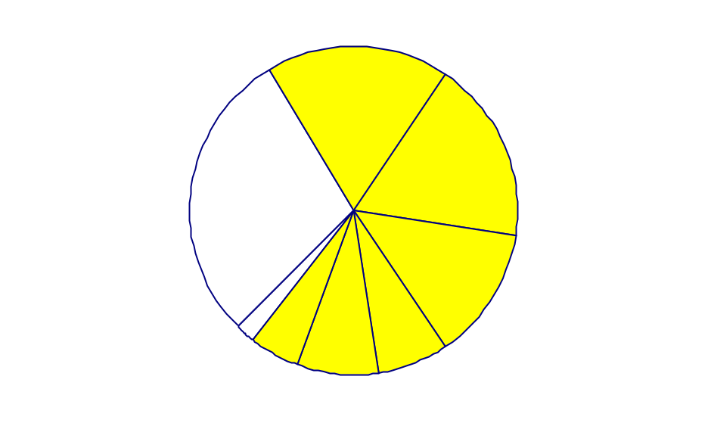
Unsere Beratungsdienstleistungen bieten wir global an
Capgemini global in 2003
Rahmendaten global
Umsatz nach Regionen
Ca. 5,754 Mrd. Euro Gesamt-umsatz
Mehr als 48.000 Mitarbeiter weltweit (Jahresende 2003)
Mehr als 300 Büros in 35 Ländern
Rund zwei Drittel der 500 weltweit größten Firmen als Kunden
An der Pariser Börse notiert
(CAC 40)
Größte “europäische” Unterneh-mensberatung
in Prozent
UK & Irland
18
Nord-
amerika
34
18
Frankreich
Anteil
Europa
69%
29
13
Benelux
2
5
7
Asien
8
Südeuropa
Skandinavien
Zentral- europa

Slide 4
Unsere Experten sind global und lokal aufgestellt
Capgemini global in 2003
Nord Amerika
Umsatz: EUR 1,716 Mio.
Mitarbeiter: 7,914
Zentraleuropa
Umsatz: EUR 437 Mio.
Mitarbeiter: 3,055
Skandinavien
Umsatz: EUR 376 Mio.
Mitarbeiter: 3,672
Frankreich
Umsatz: EUR 1,067 Mio.
Mitarbeiter: 12,884
UK & Irland
Umsatz: EUR 1,016 Mio.
Mitarbeiter: 6,496
Südeuropa
Umsatz: EUR 284 Mio.
Mitarbeiter: 4,514
Benelux
Umsatz: EUR 762 Mio.
Mitarbeiter: 7,716
Asien
Umsatz: EUR 96 Mio.
Mitarbeiter: 2,053
Rund zwei Drittel der „Fortune Global 500“ sind unsere Kunden.

Slide 5

Weltweit gehört Capgemini zu den Top 5-Beratungsunternehmen
Globale Beratungsumsätze 2002 (ohne Outsourcing)
in Millionen US$
14.900
8.908
6.075
5.394
3.170
3.100
3.000
2.368
2.364
2.358
IBM
Accen-
ture
Deloitte
Consul-
ting
Capgemini
CSC
Hewlett
Packard
Mc
Kinsey
Bearing
Point¹⁾
Mercer
Logica
CMG
= Management-Beratung
= IT-Beratung und Systemintegration
1 bis Oktober 2002 KPMG Consulting
Quelle: Management Consultant International, Annual Ranking of World‘s largest Consultancies 2003

Slide 6
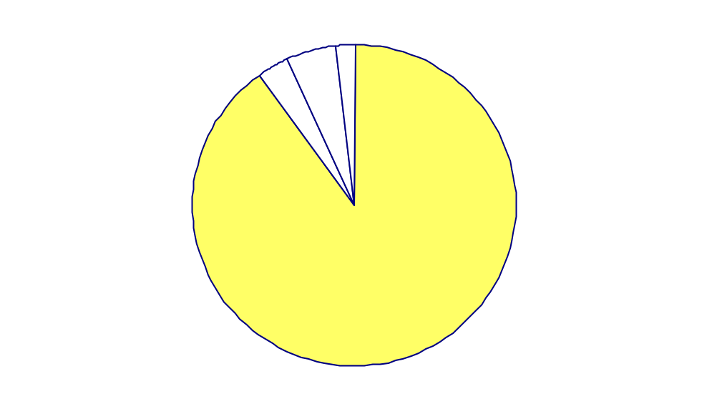
Innerhalb der Region Zentraleuropa ist Deutschland das umsatzstärkste Land
Umsatzverteilung Zentraleuropa in 2003
Lübeck
Umsatz innerhalb von Zentraleuropa
Hamburg
in Prozent
Hannover
Berlin
Osteuropa
Warschau
Österreich
2
Essen
Schweiz
5
Dresden
Düsseldorf
Dresden
3
Köln
Wroclaw
Sulzbach / Ffm.
Krakau
Offenbach
Prag
Rüsselsheim
Walldorf
Stuttgart
Bratislava
Schaffhs.
Dornach/
München
Wien
Basel
Basel
Budapest
90
Zürich
Lausanne
Deutschland
Genf

Slide 7
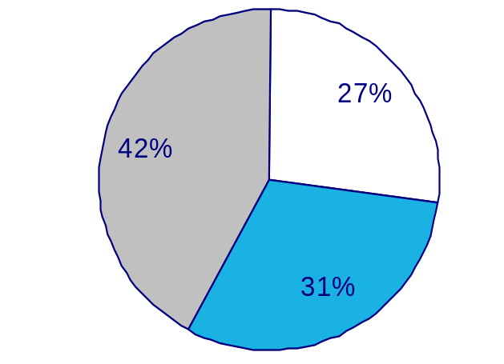
Über 3.000 Berater mit unterschiedlicher fachlicher Ausrichtung unterstützen unsere Kunden
Capgemini in Zentraleuropa
Rahmendaten Zentraleuropa in 2003
Lübeck
437 Mio. Euro Umsatz
Sieben zentraleuropäische Länder
Über 3.000¹ Berater, aufgeteilt in drei unterschiedliche fachliche Ausrichtungen:
Hamburg
Hannover
Berlin
Warschau
Essen
Dresden
Düsseldorf
Dresden
Outsourcing
Services
Köln
Wroclaw
Sulzbach / Ffm.
Krakau
Offenbach
Prag
Consulting
Services
Rüsselsheim
Walldorf
Stuttgart
Bratislava
Schaffhs.
Dornach/
München
Wien
Basel
Basel
Budapest
Zürich
Lausanne
Genf
Technology
Services
1 Ende 2003

Slide 8
In Deutschland – dem größten europäischen Beratungsmarkt – gehört Capgemini zu den führenden Beratungsunternehmen
  Umsätze 2002 in Millionen Euro
Accenture
McKinsey
Lufthansa Systems
PriceWaterhouseCoopers¹⁾
BearingPoint²⁾
Capgemini
CSC Ploenzke
Roland Berger
Boston Consulting
Atos Origin
SAP SI Systems Integration
Deloitte Consulting
A.T. Kearney
Booz Allen
Materna
594
580
557
514
488
458 (2003 = 437)
425
316
258
250
228
214
209
160
153
= Management Consulting
= IT-Consulting and system integration
1 seit Oktober 2002 integriert in IBM Business Consulting Services 2) bis Oktober 2002 KPMG Consulting
Quelle: Lünendonk-Listen 2003, Inlandsumsätze

Slide 9
Die Kombination aus hohem Wirtschafts- und IT-Wissen sichert die besten Ergebnisse für unsere Kunden
Analystenergebnisse IDC
IT-Consultants
System-Integratoren
Marktmacher
IBM Global Services Consulting
Capgemini
Compaq
HP
EDS / AT Kearney
Debis/T-Systems
CSC
Service-Consultants
Business-Integratoren
Technische Fähigkeiten
Oracle
Accenture
SAP
PWC¹
BearingPoint
Deloitte Consulting
Management-Consultants
Niemandsland
Geringe Wirtschafts- und IT-Kompetenz kann sich kein Beratungsunternehmen leisten
Roland Berger
McKinsey & Co.
Boston Consulting Group
Booz Allen & Hamilton
Wirtschaftliches Wissen
1 seit Oktober 2002 integriert in IBM Business Consulting Services
Quelle: IDC, European Consulting Competitive Analysis

Slide 10
Externe Einschätzungen durch Analysten dokumentieren den herausragenden Erfolg unseres Beratungsansatzes
Analystenergebnisse global (Auszug)
Kompetenzbereiche
Quelle
Ranking
Consumer Products, Retail, Distribution
and Transportation
Basierend auf Consultant News
und Presse-Auszügen
1
Financial Services (exkl. Outsourcing)
Dataquest, Forrester,
Kennedy Consultant News
2
Energy, Utilities & Chemicals
Entnommen aus FT Rankings
„Top Energy Companies“
2
Life Sciences
Managementeinschätzung
3
Supply Chain
(größter e-Procurement-Implementierer)
IDC
1
Technology Services
(Vision und Schlüsselfähigkeiten)
JAVA, Gartner
1

Slide 11
Unsere Kunden beurteilten uns im Rahmen einer unabhängigen Zufriedenheitsumfrage als führend
Kundenzufriedenheit
Beratungs-unternehmen
Prozess-kompe-tenz
Technik-kompe-tenz
Implemen-tierungs-kompetenz
Preis
Pünktlich-keit
Budget-treue
Bera-tungs-qualität
Qualität der Mitarbeiter vor Ort
Durch-schnitt
Capgemini
1,7
2,3
2,0
2,7
1,9
2,3
2,0
1,7
2,1
SAP Systems Integration
2,0
1,8
2,0
3,2
2,3
2,3
2,2
2,1
2,2
Pricewaterhouse-Coopers¹
2,1
2,2
2,7
3,0
2,0
2,0
2,2
2,2
2,3
T-Systems
2,3
2,0
2,6
2,8
2,5
2,7
2,2
2,4
2,4
HP Consulting
2,3
1,8
2,0
3,4
2,8
2,6
2,4
2,2
2,4
IBM Global Services
2,4
2,2
2,9
3,2
2,4
2,3
2,3
2,1
2,5
CSC Ploenzke
2,5
2,4
2,6
2,7
2,3
3,0
2,1
2,3
2,5
Siemens Business Services
2,3
2,8
2,7
3,3
2,6
3,2
2,9
2,8
2,8
KPMG
2,5
2,7
2,8
3,8
2,5
2,5
3,2
2,6
2,8
Accenture
2,5
3,0
3,4
4,2
2,3
3,2
3,1
3,1
3,1
1 seit Oktober 2002 integriert in IBM Business Consulting Services
Anm.: Bewertung nach dem Schulnotensystem: 1 (sehr gut) bis 6 (ungenügend)
Quelle: CIO März 2002

Slide 12












Ein Großteil der Top-Player gehört in Deutschland zu unseren Kunden
Capgemini-Kunden (Auswahl)
Unsere Kunden (Auswahl)
Ausgewählte Projektschwerpunkte
Internationale Firmen
In allen Branchen
Führend in ihren Bereichen
e-Strategy & Transformation
Pre- und Post-Merger Integration
Strategische Portfolioanalyse
Strategic Change
IT-Strategy und -Integration
e-Procurement
B2B-Marktplätze
Demand and Supply Planning
Sales Force Automation
Systemintegration
Cross-Channel Integration
ERP-Implementierung und Roll-out
Softwaredesign
Mit 19 der deutschen Top 20-Unternehmen haben wir erfolgreiche Projekte mit verschiedenen Problemstellungen realisiert.

Slide 13
Grundlage unseres weltweiten Kundenmanagements sind die nach Branchen aufgegliederten Sektoren
Branchenkompetenzen
Weltweites Kundenmanagement
Setzt Kundenanforderungen weltweit um
  Branchenspezifische und industrieübergreifende Lösungen
  Lösungen auf Basis von Branchen-Konsortien
Aktiviert Kompetenzen auf Weltklasse-Niveau an jedem Ort der Welt
Manufacturing,
Retail & Distribution
Energy,
Utilities & Chemicals
Life Sciences
Produkte
Financial Services
Industries
Public
Services
General Services
Services
Die branchenfokussierte Aufgliederung in Sektoren sorgt weltweit für einheitliche Lösungen und Qualität.
Notes:
Everything that we have done to set up and refine our organisation is customer-centric. We focus on the needs of our clients obsessively in order to make sure that nothing gets in the way of effective delivery and long term support.
So we address the marketplace, with Sectors, designed to give full partnership to global customers round the world, within a range of key industries.
And an additional focus on the emerging and high growth market areas, which require a specialised and highly innovative range of services.
Our sector units are powerful, global businesses in their own right, with the capability to support major businesses in all their markets, right round the world.
The sector units are also key in capturing and rolling out industry knowledge through customized service lines or sectorial solutions
Each sector contains both Global and regional accounts. The account manager’s role is to understand clients’ needs and to deliver the right solutions, backed by the right level of service:
Sector specific solutions like OSS in Telco, e-Banking in Financial Services. It’s the role of the sector to identify sector specific solutions and, if necessary, to customize generic service lines
Cross sector solutions like AM
Ecosystem partners solutions like MySAP
The Account Managers have the power to mobilize world class capability for their clients.
They have overall responsibility for all Group activities within accounts.

Slide 14
Die branchenfokussierte Aufgliederung in Sektoren bedient weltweit alle Industrien
Sektorenkompetenzen
Markt
Produkt-Industrien
Service-Industrien
Manufact. Retail &
Distribution
Energy, Utilities & Chemicals
Life Sciences
Financial Services Industries
Public
Services
General Services
Sektoren
    General Manufact.
    Automotive
    High Tech
    Aerospace
    & Defense
    Consumer Products
    Retail
    Distribution
    Chemicals
    Energy
    Utilities,
    Electricity & Gas
    Oil & Gas
    Water & Waste
    Mining
    Pharma
    Medical devices
    Agro Chemicals
    Bio-technology
    Investment Banking
    Retail Banking
    Diversified Financial
    Insurance
    Government
    Health
    Telecoms
    Media
    Business Service
    Travel & Transport
Industrien

Slide 15

Thought Leadership, ergebnisorientierte Methoden und starke Partner sind die Grundlagen überzeugender Ergebnisse
Kernelemente unseres integrierten Beratungsangebotes
Erarbeitung klarer Ergebnisse
Umsetzbare Ergebnisse
Termingerechte
Leistungserstellung
Vordenker bei den
neuesten Trends
  Kompetenzsicherung
  in allen aktuellen
  Beratungsfeldern
Thought
Leadership
Ergebnisse
Consulting
Services
Technology
Services
Outsourcing
Services
Partner-
schaften
Beratungs-
methode
Zusammenarbeit mit
Technologieführern
Technologie und Beratung
aus einer Hand
Reduzierte Schnittstellen
  Am Kundenproblem orientierter Beratungs-ansatz
Partnerschaftliche
Erarbeitung umsetzbarer
Lösungen

Slide 16
Partnerschaften mit führenden Technologie-Anbietern ergänzen unser Know-how und unsere Erfahrungen
Partnerschaften mit thematischem Schwerpunkt (Auszug)
CRM
SCM/B2B
ERP
e-Solutions
Infrastruktur
EAI
Siebel
Pivotal
Clarify
Peoplesoft
CRM SAP
SAP
Oracle
Sun
Manugistics
PTC
i2
SAP
BaaN
Peoplesoft
ATG
IBM
Core Media
Pironet
SAP
Microsoft
Oracle
Novell
Sun
Open Wave
Real Networks
IBM
Sun
Oracle
Hewlett Packard
Cisco
EMC2
Microsoft
bea
See Beyond
Tipco
IBM
Microsoft
Oracle
Web Methods
bea
Vitria
Capgemini baut seine Partnerschaften weiter aus und etabliert sich somit in vielen Bereichen als Full Service-Provider.
Notes:
It is useful to see how this approach works out in practice, so here you can see the whole picture on a single slide. It shows our combined Sector/Service Line/Alliances strategy via the offerings portfolio of the Telecom, Media and Networks GBU:
8 solutions
3 levels of partnership:
Cisco as a shareholder
Strategic alliances with 7 Technology vendors
Dozens of solution partners
Other sectors will show a different combination of alliances and service but the same clear principles are in place in them all, with our own service line strategy defining the approach and the alliance partnerships being selected to fit in with our strategy.

Slide 17
Die hohe Zufriedenheit unserer Kunden ist ein wesentliches Element unseres Erfolgs
On Time and Above Client Expectations (OTACE)
OTACE
Vorgehen
Tool zur Messung der Kundenzufriedenheit
Fokus auf:
  Termingerechte Leistungserstellung („On Time“)
  Kundenerwartungen
Gemeinsame Festlegung von Qualitätskriterien zwischen Capgemini und Kunden zum Projektstart
Bestandteil jedes größeren Projekts
Teilnahme aller Regionen, Sektoren und Service Lines am OTACE- Programm
Festhalten der Kundenerwar-tungen und Priorisierung der
Erwartungen durch den Kunden
Hohe Kundenzufriedenheit:
Kundenerwartung in 95% erfüllt, in 77% aller Fälle übertroffen
Termineinhaltung in 98% der Fälle
80% unserer Projekte sind
Folgeaufträge
Während des Projekts Feed-back-Schleifen und Anpassung an die Kundenwünsche
Regelmäßige Bewertung der Beratungsergebnisse durch den Kunden, spätestens nach sechs Monaten

Slide 18
Change Management

Slide 19
Agenda
A few thoughts on change
The emotional cycle of change
A model for organizational change
A model for personal response to change
CSFs for implementing change.
Notes:
5
5

Slide 20
A perspective on change ..
“Who the hell wants to hear actors talk?”
  - Harry M. Warner, Warner Brothers Pictures, c. 1927
“Sensible and responsible women do not want to vote”
  - Grover Cleveland, 1905
“Everything that can be invented has been invented”
  - Charles H. Duell, Director of the US Patent Office, 1899
“Heavier than air flying machines are impossible”
  - Lord Kelvin, President of the Royal Society, c. 1895
“Ruth made a big mistake when he gave up pitching”
  - Trisk Speaker, 1921
“There is no likelihood man can ever tap the power of the atom”
  - Robert Millikan, Nobel Prize in Physics, 1923
Notes:
6
6

Slide 21
What is different about change today?
“The problem with the future is it isn’t what it used to be”
Paul Valery
“To stay where you are you must run as fast as you can. To get anywhere, you must run fast yet”
The Queen to Alice in “Through the Looking Glass”, 1872
Notes:
7
7

Slide 22
The rules are changing
The Why
Environmental, societal change:
Technology.
Economy.
Government.
Society.
Customer, competitors.
?
The What
Organizational change:
Strategies.
Structures, delayering.
Practices.
Processes.
Products.
?
The How
Personal change:
Role.
Responsibilities.
Habits.
Thinking.
Values.
Behaviors.
?
Notes:
8
8

Slide 23










The forces of change
Customers / Markets
Technical
Economic
Competition
Suppliers
Environmental
Demographic
Political / Governmental
The question used to be “what changes have you recently experienced?”. The new question is “what changes haven’t you experienced in the past several years?
Notes:
9
9

Slide 24
The rate of change is accelerating
TRANSITION
·
S-U E G M D
S-U E G M D
S-U E G M D
S-U E G M D
S-U E G M D
S-U E G M D
S-U E G M D
S-U E G M D
Products.
Markets.
Strategies.
START-UP EMERGE GROW MATURE DECLINE
START-UP
EMERGE
GROW
MATURE
DECLINE
Historically long cycles are compressing at an exponential rate.
Notes:
10
10

Slide 25
Agenda
A few thoughts on change
The emotional cycle of change
A model for organizational change
A model for personal response to change
CSFs for implementing change.
Notes:
5
5

Slide 26
Change is a process that is inevitable, natural and consistent
Major change causes emotional responses
Understanding the emotional cycle of change can help us to deal with it.
Significant emotional shifts occur while creating major change.
These shifts follow a predictable sequence, thus producing an emotional cycle of change.
We don’t think our emotional shifts are unique.
The shifts become less severe.
We can understand the reactions of other people in the organisation.
Notes:
16
16

Slide 27
The emotional cycle of change has five stages
Rewarding
Uninformed
Completion
Optimism
(Satisfaction)
(Honeymoon)
Optimism/Enthusiasm
Informed
Positive Energy
Optimism
Informed
(Confidence)
Pessimism
Hopeful
(Doubt)
Realism
(Hope)
Time
Source : Daryl Conner
Notes:
17
17

Slide 28
The emotional cycle of change
UNINFORMED OPTIMISM
Honeymoon period.
Ideas look great on paper.
All major obstacles appear to have been anticipated.
Uninformed
Optimism
(Honeymoon)
Positive energy.
Time
Source : Daryl Conner
Notes:
18
18

Slide 29
The emotional cycle of change
INFORMED PESSIMISM
Problems surface.
Few solutions are obvious.
Morale drops (“Why did I get involved with this in the first place?”).
Balances out Uninformed Optimism.
Positive energy.
Informed
Pessimism
(Doubt)
Time
Source : Daryl Conner
Notes:
19
19

Slide 30
The emotional cycle of change
HOPEFUL REALISM
A turning point occurs.
A sense of accomplishment replaces a sense of pushing against problems.
Problems have not all disappeared.
People’s hopes based on realistic data.
Positive energy.
Hopeful
Realism
(Hope)
Time
Source : Daryl Conner
Notes:
20
20

Slide 31
The emotional cycle of change
INFORMED OPTIMISM
Optimism continues to develop.
Fresh bursts of energy appear.
Acceptance widens.
Confidence soars.
Positive energy.
Informed
Optimism
(Confidence)
Time
Source : Daryl Conner
Notes:
21
21

Slide 32
The emotional cycle of change
REWARDING COMPLETION
Successful change has been made.
Official change effort has been completed.
Outcomes are frequently different than anticipated in Uninformed Optimism.
Rewarding
Completion
(Satisfaction)
Positive energy.
Time
Source : Daryl Conner
Notes:
22
22

Slide 33
The emotional cycle of change
Uninformed Optimism
Honeymoon period
Ideas look great on paper.
All major obstacles appear to have been anticipated.
Rewarding Completion (Satisfaction)
Successful change has been made.
Official change effort has been completed.
Outcomes are frequently different than anticipated in Uninformed Optimism.
Informed Optimism (confidence)
Optimism continues to develop.
Fresh bursts of energy appear.
Acceptance widens.
Confidence soars.
Positive energy.
Informed Pessimism
(doubt)
Problems surface.
Few solutions are obvious.
Morale drops (“Why did I ever get involved with this in the first place”).
Balances out Uniformed Optimism.
Hopeful Realism (hope)
A turning point occurs.
A sense of accomplishment replaces a sense of pushing against problems.
Problems have not all disappeared - peoples’ hopes based on realistic data.
Time
Source : Daryl Conner
Notes:
23
23

Slide 34
Agenda
A few thoughts on change
The emotional cycle of change
A model for organizational change
A model for personal response to change
CSFs for implementing change.
Notes:
5
5

Slide 35
Change truths
No matter how well motivated, an individual cannot make change alone.
The organization changes only as the percentage of people within the
organization change.
Members of organizations are as important as leaders in changing
organizations.
The Myth . . .
Instant.
Painless.
Quick.
The Reality . . .
Slow.
Expensive.
Difficult.

Slide 36
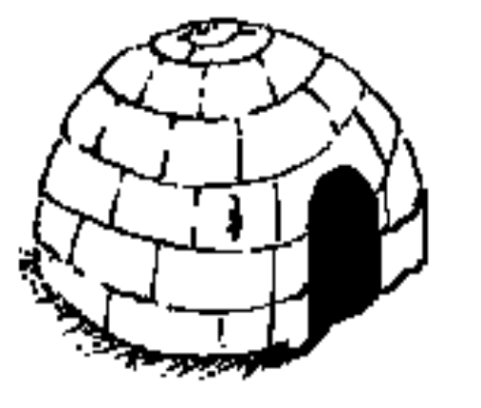


A model for organizational change (Kurt Lewin)
RE-FREEZING
UNFREEZING
CHANGE & MOVEMENT
Notes:
28
28

Slide 37

UNFREEZING
Creating motivation and readiness to change
Techniques to reinforce unfreezing ..
Acknowledge feelings and empathise
Give people as much information about the change as possible
Say what will not change
Treat the past with respect
Help others to see the gap
Notes:
29
29

Slide 38
CHANGE & MOVEMENT
Guiding through the transition
Techniques to reinforce movement ..
Provide focus and direction
Strengthen peoples' connections to one another
Open up two way communications
Provide the individual with a specific role in the change process
Provide leadership and tenacity
Notes:
30
30

Slide 39

RE-FREEZING
Integrating the new point of view
Techniques to reinforce re-freezing
(before reverting to the old point of view)
Ensure that individuals and leaders are reinforced for new behaviour
Implement quick results and highlight successes
Build feedback mechanisms
Celebrate!
Notes:
31
31

Slide 40


The model for organisational change
STEP 3: Re-freezing
(Integrating the new point of view)
Implement quick requests and highlight successes.
Ensure the individuals and leaders reinforce the new behaviour.
Build feedback mechanisms.
Celebrate.
STEP 1: Unfreezing
(Creating motivation and readiness to change)
Acknowledge feelings and empathise.
Give people as much information about the change as possible.
Say what will not change.
Treat the past with respect.
Help others see the gap.
STEP 2: Change and movement
(Guiding through the transition)
Provide focus and direction.
Strengthen people’s connections to one another.
Provide the individual with a specific role in the change process.
Provide leadership and tenacity.
Notes:
32
32

Slide 41
Agenda
A few thoughts on change
The emotional cycle of change
A model for organizational change
A model for personal response to change
CSFs for implementing change.
Notes:
5
5

Slide 42



A model for personal response to change by Kubler Ross
Active
Anger
Acceptance
Receive
Bargaining
"bad" news
Emotional
Response
Denial
Depression
Passive
Time
Notes:
34
34

Slide 43
Denial
Individuals who stay in denial too long may vary:
The problem has corrected itself .. it will be over soon.
Exhibits apathy and numbness.
Rationalise change away.
Notes:
35
35

Slide 44
Anger
Individuals angry about the change may:
Sabotage the change efforts.
Play shoot the messenger.
Withdraw from the team.
Notes:
36
36

Slide 45
Bargaining
An individual may bargain with you by:
Cutting a deal to spare them.
Being a "killer concern generator" to redirect problem solving.
Notes:
37
37

Slide 46
Depression
An individual depressed about change may:
Express a loss of control over the work environment
Increase absenteeism
Notes:
38
38

Slide 47

Acceptance
Signs of individuals accepting change include:
Expressing ownership for solutions
Being focused on achieving benefits
Notes:
39
39

Slide 48
Agenda
A few thoughts on change
The emotional cycle of change
A model for organizational change
A model for personal response to change
CSFs for implementing change.
Notes:
5
5

Slide 49

Critical success factors for implementing major change
Build a shared vision
Set clear goals
Involve participants
Encourage cultural awareness
Expect continuous communication
Integrate business
Develop realistic resource requirements
Recognise change in timely fashion
Tenacious and persistent leadership
Notes:
42
42

Slide 50
Based on research, there are a number of reasons why transformation efforts fail...
Not establishing a great enough sense of urgency
Not creating a powerful enough guiding coalition
Lacking a vision
Under communicating the vision by a factor of ten
Not removing obstacles to the new vision
Not systematically planning for creating short term wins
Declaring victory too soon
Not anchoring changes in the corporation's culture
Lack of a measurement system
Failure to involve people
Source : (of the first 8) - Harvard Business Review, March/April 1995, “Leading Change - Why Transformation Efforts Fail”
Notes:
44
44

Slide 51
Change Management embedded within an IT-Project
Phase
Business
Blue Print
Template Realization
Roll-
Out Phase
Streams
Project Management
Front office
Logistics
Finance and Controlling
Reporting
Basis and IT-Infrastructure
Change Management

Slide 52
Change Management had to focus on three main phases
Phase
Strategic
Phase
Alignment
Phase
Roll-
Out Phase
Activities
Develop Alignment Process
Develop End User Review Process
Track alignment and end user review progress
Start team building activities
Develop overall Change Management Strategy
Create overall Communication Strategy
Develop overall Training Approach
1
2
3
4
5
6
7
Change Management
1
2
3
4
5
6
7
Communication/Mobilization
1
2
3
4
5
6
Training

Slide 53
Within the Roll-out phase Change Management focus on clear methodologies designed for three main areas
1
2
3
4
5
6
7
Preparation
Phase
Focus
Interviews
Trainings for CA /SMEs
Detailed Gap Analysis
Local
Transformation Maps
Change Activities
Preparation
Phase
(Org.
Alignment)
Focus
Interviews
Re-absorbtion Process/
Plus Delta Survey
Change Management
1
2
3
4
5
6
7
Local
Communication
Strategy
Communication Infra-structure
Set-up
Info Session
Info Fair
Info Corners
Customer/Vendor Communication
Go-Live Communication
Temperature Checks/e-bulletins, Intranet, Motivational Events etc.
Mobilization and Communication
1
2
3
4
5
6
Training Approach
End
User
Training
Knowledge Evaluation & Certification
Super
User
Training
Skill Development Analysis & Plan
Training
Materials
Super
User
Training
Training

Slide 54
Key Change Management and tools for the Roll-out Preparation Phase
1
2
3
4
5
6
7
Preparation
Phase
Focus
Interviews
Trainings for CA /SMEs
Detailed Gap Analysis
Local
Transformation Maps
Change Activities
Preparation
Phase
(Org.
Alignment)
Focus
Interviews
Re-absorbtion Process/
Plus Delta Survey
Change Management
Activities
Tools
Establish initial relationship between local management and project team
Prepare and facilitate pre-roll-out preparation meetings
Introduce local management to Project
Identify local team requirements, roles and responsibilities
Prepare Kick-off event
Preparation and orientation meetings
Roll- out preparation guidelines
Kick-off meeting

Slide 55
Key activities and tools to conduct Focus Interviews
1
2
3
4
5
6
7
Preparation
Phase
Focus
Interviews
Trainings for CA /SMEs
Detailed Gap Analysis
Local
Transformation Maps
Change Activities
Preparation
Phase
(Org.
Alignment)
Focus
Interviews
Re-absorbtion Process/
Plus Delta Survey
Change Management
Activities
Tools
Develop/customize Interview Template
Select interviewees together with local HR
conduct Interviews
Evaluate Interviews
Coordinate interviews
Prepare presentation for local management
Focus Interview Template
Focus Interview Results Presentation Template
Executive Summary

Slide 56
Key activities and tools to perform CA/SMEs training
1
2
3
4
5
6
7
Preparation
Phase
Focus
Interviews
Trainings for CA /SMEs
Detailed Gap Analysis
Local
Transformation Maps
Change Activities
Preparation
Phase
(Org.
Alignment)
Focus
Interviews
Re-absorbtion Process/
Plus Delta Survey
Change Management
Activities Change Training
Tools
Develop/customize CA and Super Users Overview
Develop/customize CA and SME Training
Facilitate CA trainings
Facilitate SME trainings
Overview Presentation Change Management
Change Agents Trainings
SME Trainings

Slide 57
Key activities and tools to perform the Detailed Gap Analysis
1
2
3
4
5
6
7
Preparation
Phase
Focus
Interviews
Trainings for CA /SMEs
Detailed Gap Analysis
Local
Transformation Maps
Change Activities
Preparation
Phase
(Org.
Alignment)
Focus
Interviews
Re-absorbtion Process/
Plus Delta Survey
Change Management
Activities
Tools
Develop/customize guidelines for detailed Gap Analysis together with PMO
Prepare and facilitate local detailed Gap Analysis Kick-off Meeting
Co-facilitate Gap Analysis Meetings between local and central SMEs and Change Agents
Consolidate systems gaps, legal regulatory requirements and process/org. changes
High Level Gap Analysis Tool
Detailed Gap Analysis Tool

Slide 58
Key activities and tools to create Local Transformation Maps
1
2
3
4
5
6
7
Preparation
Phase
Focus
Interviews
Trainings for CA /SMEs
Detailed Gap Analysis
Local
Transformation Maps
Change Activities
Preparation
Phase
(Org.
Alignment)
Focus
Interviews
Re-absorbtion Process/
Plus Delta Survey
Change Management
Activities
Tools
Consolidate data from detailed Gap Analysis and Competency Development Analysis (Meetings with HR, Management & Stream Leads)
Allocate gaps to affected departments
Develop local transformation maps (Process, Organizational and Competency Changes)
Facilitate Change Decision Meeting
Facilitate final sign-off of discussed changes
Transformation Map
Detailed Gap Analysis Tool
Agenda Decision Meeting Template
Final Decision Meeting Template

Slide 59
Key activities and tools to facilitate Change Activities
1
2
3
4
5
6
7
Preparation
Phase
Focus
Interviews
Trainings for CA /SMEs
Detailed Gap Analysis
Local
Transformation Maps
Change Activities
Preparation
Phase
(Org.
Alignment)
Focus
Interviews
Re-absorbtion Process/
Plus Delta Survey
Change Management
Activities
Tools
Assign Roles and responsibilities for identified changes (CM, SMEs, CA, Local HR, Local Process Owner)
Develop local tracking sheet and local change calendar
Facilitate, coordinate and track change activities
Create and track open Issue List
Facilitate web based tracking
Transformation Map
RACI
Change activities tracking tool
Feedback form for change activities
Change calendar
Issue List

Slide 60
Key activities and tools to develop and conduct the Reabsorption Process/Plus Delta Survey
1
2
3
4
5
6
7
Preparation
Phase
Focus
Interviews
Trainings for CA /SMEs
Detailed Gap Analysis
Local
Transformation Maps
Change Activities
Preparation
Phase
(Org.
Alignment)
Focus
Interviews
Re-absorbtion Process/
Plus Delta Survey
Change Management
Activities
Tools
Develop/Customize local re-absorption strategy
Coordinate re-absorption process
Develop and conduct “Plus/Delta” survey
Facilitate and prepare local Hand-over Meeting
Plus/Delta Survey
Re-absorption Matrix
Hand-over Presentation

Slide 61
Key activities and tools to develop Local Communication Strategy
1
2
3
4
5
6
7
Local
Communication
Strategy
Communication Infra-structure
Set-up
Info Session
Info Fair
Info Corners
Customer/ Vendor Communication
Go-Live Communication
Temperature Checks/e-bulletins, Intranet, Motivational Events etc.
Mobilization and Communication
Activities
Tools
Identify local country stakeholders– both internal and external
Select and design specific communication tools that would best suit the needs of project and country members
Design communication strategy uniting stakeholders, communication tools and roll-out time frames
Counry communcation presentation

Slide 62
Key activities and tools to set up Communication Infrastructure
1
2
3
4
5
6
7
Local
Communication
Strategy
Communication Infra-structure
Set-up
Info Session
Info Fair
Info Corners
Customer/ Vendor Communication
Go-Live Communication
Temperature Checks/e-bulletins, Intranet, Motivational Events etc.
Mobilization and Communication
Activities
Tools
Set up communication structure to suite and compliment local communication
Preparation and orientation meetings
Temperature Checks
E-Bulletins
Intranet

Slide 63
Key activities and tools to conduct Info Session
1
2
3
4
5
6
7
Local
Communication
Strategy
Communication Infra-structure
Set-up
Info Session
Info Fair
Info Corners
Customer/ Vendor Communication
Go-Live Communication
Temperature Checks/e-bulletins, Intranet, Motivational Events etc.
Mobilization and Communication
Activities
Tools
Develop overview presentaion
Coordinate logistical set up with local Change team
Facilitate feedback process
Project overview presentation

Slide 64
Key activities and tools to conduct Info Fair
1
2
3
4
5
6
7
Local
Communication
Strategy
Communication Infra-structure
Set-up
Info Session
Info Fair
Info Corners
Customer/ Vendor Communication
Go-Live Communication
Temperature Checks/e-bulletins, Intranet, Motivational Events etc.
Mobilization and Communication
Activities
Tools
Coordinate Presentations/plots development for each presenting stream
Co-facilitate the event and its presentation with local Change team
Arrange, collect an evaluate feedback
Preparation guidelines
Info fair Introduction presentation
Presentations/plots
Feedback forms

Slide 65
Key activities and tools to conduct Info Corners
1
2
3
4
5
6
7
Local
Communication
Strategy
Communication Infra-structure
Set-up
Info Session
Info Fair
Info Corners
Customer/ Vendor Communication
Go-Live Communication
Temperature Checks/e-bulletins, Intranet, Motivational Events etc.
Mobilization and Communication
Activities
Tools
Co-arrange and facilitate the events together with local Change team
Coordinate presentations developed by each stream
Arrange, collect and evaluate feedback
Info corner guidelines
Info corner feedback sheets and evaluation

Slide 66
Key activities and tools to develop and conduct the Customer and Vendor Communication
1
2
3
4
5
6
7
Local
Communication
Strategy
Communication Infra-structure
Set-up
Info Session
Info Fair
Info Corners
Customer/ Vendor Communication
Go-Live Communication
Temperature Checks/e-bulletins, Intranet, Motivational Events etc.
Mobilization and Communication
Activities
Tools
Collaborate with local management to develop customized public information about the roll-out
Coordinate the approval process with the US
Cooriante development of F&Q sessions for all employees
Update and customize intranet communication and files, describing the changes of printed documents
Intranet documents
Customer and Vendor letter
Frequently asked questions and answers

Slide 67
Key activities and tools for the Go-Live Communication
1
2
3
4
5
6
7
Local
Communication
Strategy
Communication Infra-structure
Set-up
Info Session
Info Fair
Info Corners
Customer/Vendor Communication
Go-Live Communication
Temperature Checks/e-bulletins, Intranet, Motivational Events etc.
Mobilization and Communication
Activities
Tools
Co facilitate Post go live support
Arrange Power up activities and develop appropriate plots
Coordinate and facilitate Birth day event
Conduct and evaluate Plus-Delta Survey
Plus - Delta Surveys
Go live plots
Power-up week flyer
Invitations
Birthday invitation

Slide 68
Key activities and tools to develop the Training Approach
1
2
3
4
5
6
Training Approach
End
User
Training
Knowledge Evaluation & Certification
Super
User
Training
Skill Development Analysis & Plan
Training
Materials
Super
User
Training
Training
Activities
Tools
Develop Train the Trainer Concept
Perform Basic Module & Key Processes Training prior to Gap Analysis
Facililate Super & Key User training by experienced Tech Data IT Trainers
Arrange Refresher and Train the Trainer courses for Super Users to enable effective End User training
Enable Super & Key Users to act as advocates for the Change Process
Training Strategy
Training Kick-Off presentation

Slide 69
Key activities and tools Skill to conduct Development Analysis
1
2
3
4
5
6
Training Approach
End
User
Training
Knowledge Evaluation & Certification
Super
User
Training
Skill Development Analysis & Plan
Training
Materials
Super
User
Training
Training
Activities
Tools
Identify and document current employees role, key activities and system knowledge
Map future foles and corresponding knowledge of R/3 processes
Indentify Gaps and changes resulting for the Gap Analysis
Identify and develop individul training courses & competency workshops
Build company training schedules
Track Skill Development of employees
Skill Development Matrix

Slide 70
Key activities to develop the Training Material
1
2
3
4
5
6
Training Approach
End
User
Training
Knowledge Evaluation & Certification
Super
User
Training
Skill Development Analysis & Plan
Training
Materials
Super
User
Training
Training
Activities
Tools
Update Training Material Master
Incorporate local adjustments (e.g. Legal requirements) into training materials
Arrange timely translation into local language (English, French, German, Spanish, Portuguese, EEL)
Assure constant Review & Improvement in case of (Process) Changes
List of Training Materials

Slide 71
Key activities and tools Super User Training
1
2
3
4
5
6
Training Approach
End
User
Training
Knowledge Evaluation & Certification
Super
User
Training
Skill Development Analysis & Plan
Training
Materials
Super
User
Training
Training
Activities
Tools
Provide Overview & Navigation training
Deliver Basic Module Training
Arrange and delliver Key Process Workshops in preparation for the Gap Analysis
Provide Role Specific Training to teach specific process and system knowledge
Schedule and deliver in country Train the Trainer course to prepare for End User training delivery
Offer Coaching when needed
Super & Key User Training Schedule
Course Contents

Slide 72
Key activities and tools End User Training
1
2
3
4
5
6
Training Approach
End
User
Training
Knowledge Evaluation & Certification
Super
User
Training
Skill Development Analysis & Plan
Training
Materials
Super
User
Training
Training
Activities
Tools
Deliver Overview & Navigation training
Provide Role specific courses
Enable individual exercising and coaching
Provide specific sales training on go-live weekend
Offer refresher training & coaching where needed
End User Training Schedule

Slide 73
Key activities and tools for the Knowledge Evaluation & Certification
1
2
3
4
5
6
Training Approach
End
User
Training
Knowledge Evaluation & Certification
Super
User
Training
Skill Development Analysis & Plan
Training
Materials
Super
User
Training
Training
Activities
Tools
Conduct Test for End Users
Track test results & attandances
Schedule Refresher courses, coaching & on-site support where needed
Award company internal Certificate to Super & Key Users as internal SAP R/3 trainers
Award certificate to End Users
Collect, evaluate and communicate training feedback
Provide post-go live training support if necessary
Certificate for Super & Key Users
Attandance & Test form
Feedback form

Slide 74
Roll-out Project Plan (Example)
Aug.
Sept.
Oct.
Nov.
Dec.
Jan.
Feb.
Mar.
Preparation Meetings with Management
Focus Interviews
POWWOW & High Level Gap Analysis
Tailor CM and Communication Strategies
Super User Training
Change Agent Training
Project Kick-off
Detailed Gap Analysis
Skills Inventory
Info-session
X-functional decision meetings
Transformation Maps
Info-fair
Transf. activities (org/proc/comp workshops)
Info-corners
SU training prep. (refresher/ttt/syst.)
EU training
Reabsorption strategy
EU training labs
Plus/Delta surveys
Motivational events (on going)
Communication activities
Change Management
Training
Communication
Go live

Slide 75
Vielen Dank für Ihre Aufmerksamkeit!

